Slide 1
Foreign Tax Credit
4491-24 Foreign Tax Credit v11.0 VO.pptx
Form 1040 Line 47
Pub 4012 Tab 5

Slide 2
Foreign Tax Credit
Reported to TP on 1099 INT or 1099 DIV
Only in scope total if <$300 ($600 MFJ)
Link from 1040, Line 47 and enter at the top of Form 1116
Do NOT put directly on 1040 – can cause problems
The rest of Form 1116 is Out Of Scope

Slide 3
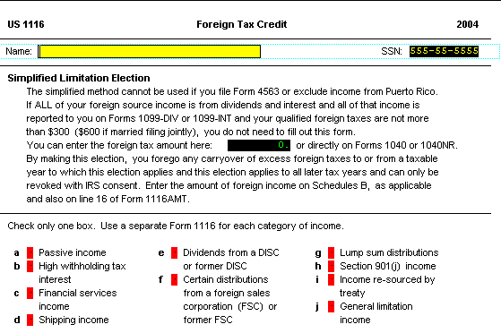
2008
2005

